Slide 1
Module 5 – DynamoDB on AWS

Slide 2

Objectives
Understanding Dynamo DB
Core Components of Dynamo DB
Primary Keys and Sort Keys
Dynamo DB Streams
Creating Tables
Loading Data into Tables
Backup and Restore

Slide 3
What Is Amazon DynamoDB?
Amazon DynamoDB is a fully managed NoSQL database service that provides fast and predictable performance with seamless scalability. DynamoDB lets you offload the administrative burdens of operating and scaling a distributed database, so that you don't have to worry about hardware provisioning, setup and configuration, replication, software patching, or cluster scaling.

Slide 4
High Availability and Durability
DynamoDB automatically spreads the data and traffic for your tables over a sufficient number of servers to handle your throughput and storage requirements, while maintaining consistent and fast performance. All of your data is stored on solid state disks (SSDs) and automatically replicated across multiple Availability Zones in an AWS region, providing built-in high availability and data durability. You can use global tables to keep DynamoDB tables in sync across AWS Regions.

Slide 5
DynamoDB Core Components
Tables, Items, and Attributes
1
Primary Key
2
Secondary Indexes
3
DynamoDB Streams
4

Slide 6
Tables, Items, and Attributes
Tables – Similar to other database systems, DynamoDB stores data in tables. A table is a collection of data. For example, see the example table called People that you could use to store personal contact information about friends, family, or anyone else of interest.
Items – Each table contains zero or more items. An item is a group of attributes that is uniquely identifiable among all of the other items. In a People table, each item represents a person.
Attributes – Each item is composed of one or more attributes. An attribute is a fundamental data element, something that does not need to be broken down any further. For example, an item in a People table contains attributes called PersonID, LastName, FirstName, and so on.

Slide 7

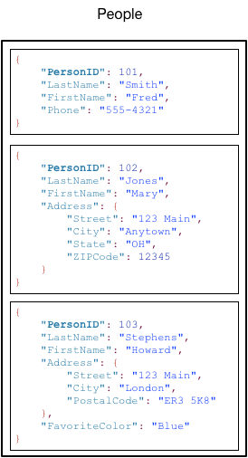
Example - Tables, Items, and Attributes

Slide 8
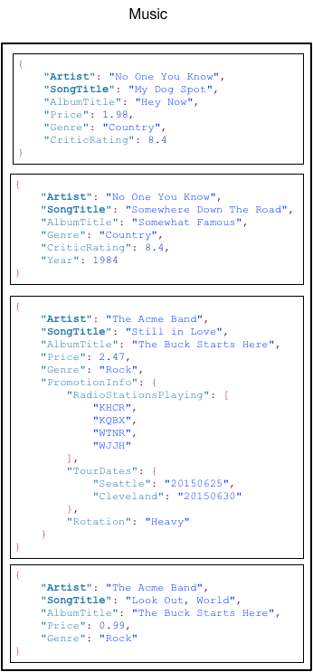
Example - Tables, Items, and Attributes with Two Keys

Slide 9
Primary Key
When you create a table, in addition to the table name, you must specify the primary key of the table. The primary key uniquely identifies each item in the table, so that no two items can have the same key.
DynamoDB supports two different kinds of primary keys:
Partition key – A simple primary key, composed of one attribute known as the partition key.
Partition key and sort key – Referred to as a composite primary key, this type of key is composed of two attributes. The first attribute is the partition key, and the second attribute is the sort key.

Slide 10

Secondary Indexes
You can create one or more secondary indexes on a table. A secondary index lets you query the data in the table using an alternate key, in addition to queries against the primary key. DynamoDB doesn't require that you use indexes, but they give your applications more flexibility when querying your data. After you create a secondary index on a table, you can read data from the index in much the same way as you do from the table.

Slide 11
Types of Indexes supported by Dynamo DB
Global secondary index – An index with a partition key and sort key that can be different from those on the table.
Local secondary index – An index that has the same partition key as the table, but a different sort key.
Note - You can define up to 5 global secondary indexes and 5 local secondary indexes per table.

Slide 12
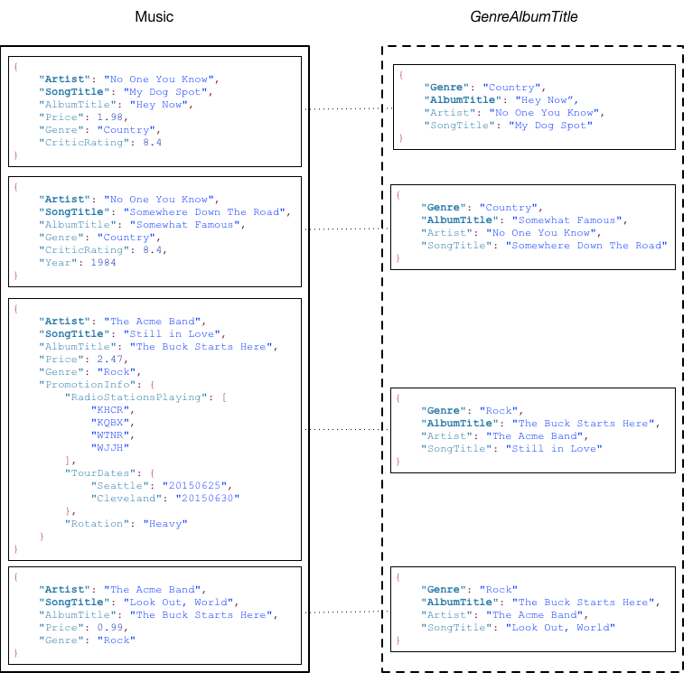
Example – Using Indexes

Slide 13
DynamoDB Streams
DynamoDB Streams is an optional feature that captures data modification events in DynamoDB tables. The data about these events appear in the stream in near real time, and in the order that the events occurred.
Each event is represented by a stream record. If you enable a stream on a table, DynamoDB Streams writes a stream record whenever one of the following events occurs:
A new item is added to the table: The stream captures an image of the entire item, including all of its attributes.
An item is updated: The stream captures the "before" and "after" image of any attributes that were modified in the item.
An item is deleted from the table: The stream captures an image of the entire item before it was deleted.

Slide 14
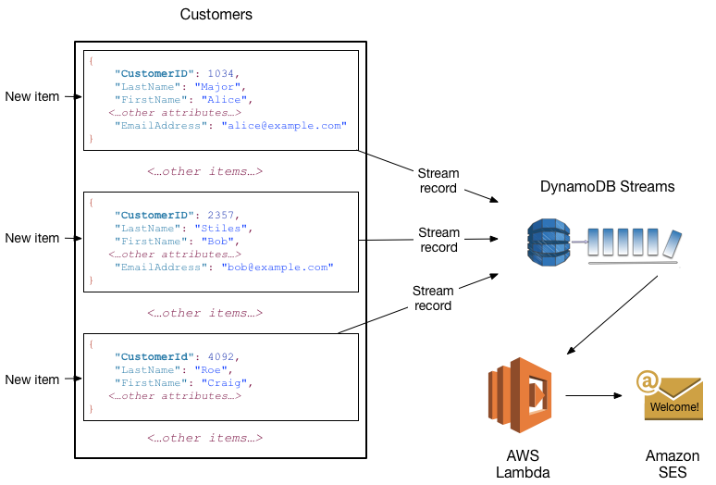
Example – DynamoDB Stream
You can use DynamoDB Streams together with AWS Lambda to create a trigger—code that executes automatically whenever an event of interest appears in a stream.

Slide 15
The DynamoDB API
To work with Amazon DynamoDB, your application must use a few simple API operations. The following is a summary of these operations, organized by category.
Control Plane
Data Plane
DynamoDB Streams

Slide 16
Control Plane
Control plane operations let you create and manage DynamoDB tables. They also let you work with indexes, streams, and other objects that are dependent on tables.
CreateTable – Creates a new table. Optionally, you can create one or more secondary indexes, and enable DynamoDB Streams for the table.
DescribeTable – Returns information about a table, such as its primary key schema, throughput settings, index information, and so on.
ListTables – Returns the names of all of your tables in a list.
UpdateTable – Modifies the settings of a table or its indexes, creates or remove new indexes on a table, or modifies DynamoDB Streams settings for a table.
DeleteTable – Removes a table and all of its dependent objects from DynamoDB.

Slide 17
Data Plane
Data plane operations let you perform create, read, update, and delete (also called CRUD) actions on data in a table. Some of the data plane operations also let you read data from a secondary index.
Creating Data
Reading Data
Updating Data
Deleting Data

Slide 18
Creating Data
PutItem – Writes a single item to a table. You must specify the primary key attributes, but you don't have to specify other attributes.
BatchWriteItem – Writes up to 25 items to a table. This is more efficient than calling PutItem multiple times because your application only needs a single network round trip to write the items. You can also use BatchWriteItem for deleting multiple items from one or more tables.

Slide 19

Reading Data
GetItem – Retrieves a single item from a table. You must specify the primary key for the item that you want.
BatchGetItem – Retrieves up to 100 items from one or more tables
Query – Retrieves all items that have a specific partition key. You must specify the partition key value
Scan – Retrieves all items in the specified table or index. You can retrieve entire items, or just a subset of their attributes.

Slide 20
Updating Data
UpdateItem – Modifies one or more attributes in an item. You must specify the primary key for the item that you want to modify. You can add new attributes and modify or remove existing attributes. You can also perform conditional updates, so that the update is only successful when a user-defined condition is met.

Slide 21
Deleting Data
DeleteItem – Deletes a single item from a table. You must specify the primary key for the item that you want to delete.
BatchWriteItem – Deletes up to 25 items from one or more tables. This is more efficient than calling DeleteItem multiple times because your application only needs a single network round trip to delete the items. You can also use BatchWriteItem for adding multiple items to one or more tables.

Slide 22
DynamoDB Streams
DynamoDB Streams operations let you enable or disable a stream on a table, and allow access to the data modification records contained in a stream.
ListStreams – Returns a list of all your streams, or just the stream for a specific table.
DescribeStream – Returns information about a stream, such as its Amazon Resource Name (ARN) and where your application can begin reading the first few stream records.
GetShardIterator – Returns a shard iterator, which is a data structure that your application uses to retrieve the records from the stream.
GetRecords – Retrieves one or more stream records, using a given shard iterator.

Slide 23
Read Consistency
Amazon DynamoDB is available in multiple AWS regions around the world. Each region is independent and isolated from other AWS regions. For example, if you have a table called People in the us-east-2 region and another table named People in the us-west-2 region, these are considered two entirely separate tables.
DynamoDB supports eventually consistent and strongly consistent reads.
Eventually Consistent Reads
Strongly Consistent Reads

Slide 24
Throughput Capacity for Reads and Writes
One read capacity unit represents one strongly consistent read per second, or two eventually consistent reads per second, for an item up to 4 KB in size.
One write capacity unit represents one write per second for an item up to 1 KB in size.
DynamoDB provides the following mechanisms for managing throughput:
DynamoDB auto scaling
Provisioned throughput
Reserved capacity

Slide 25
Demo – Creating IAM Credentials to Access DynamoDB

Slide 26
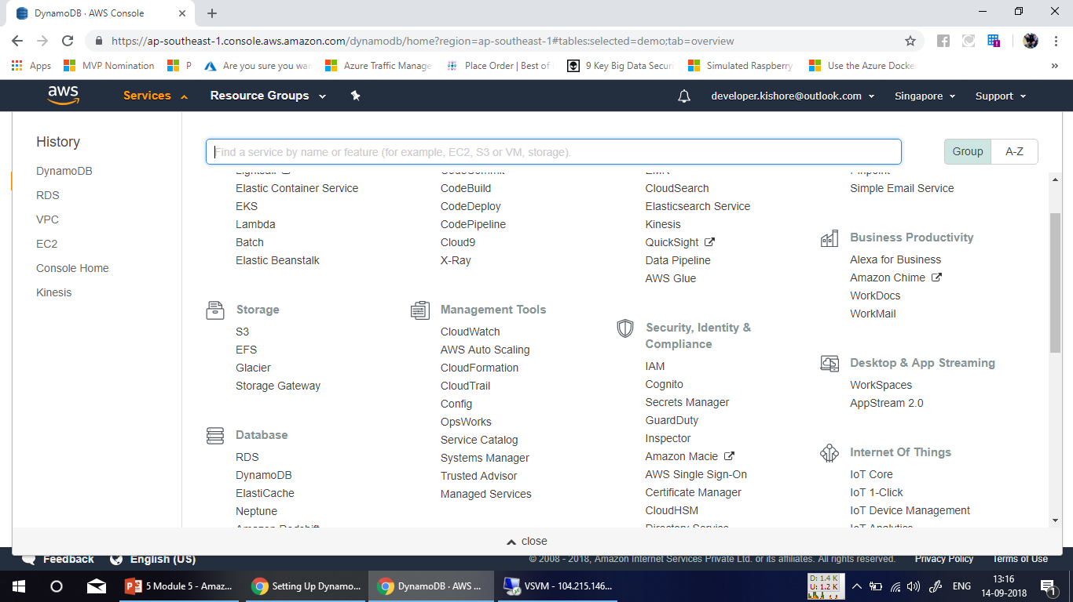

Slide 27
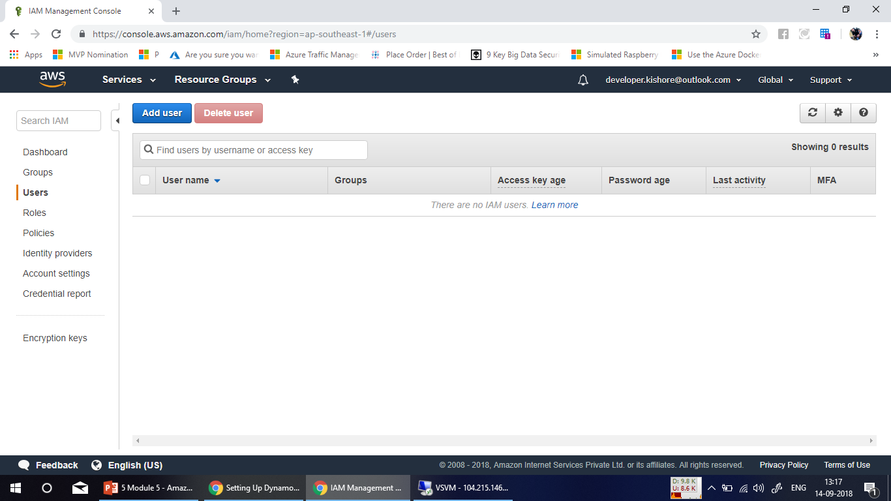

Slide 28
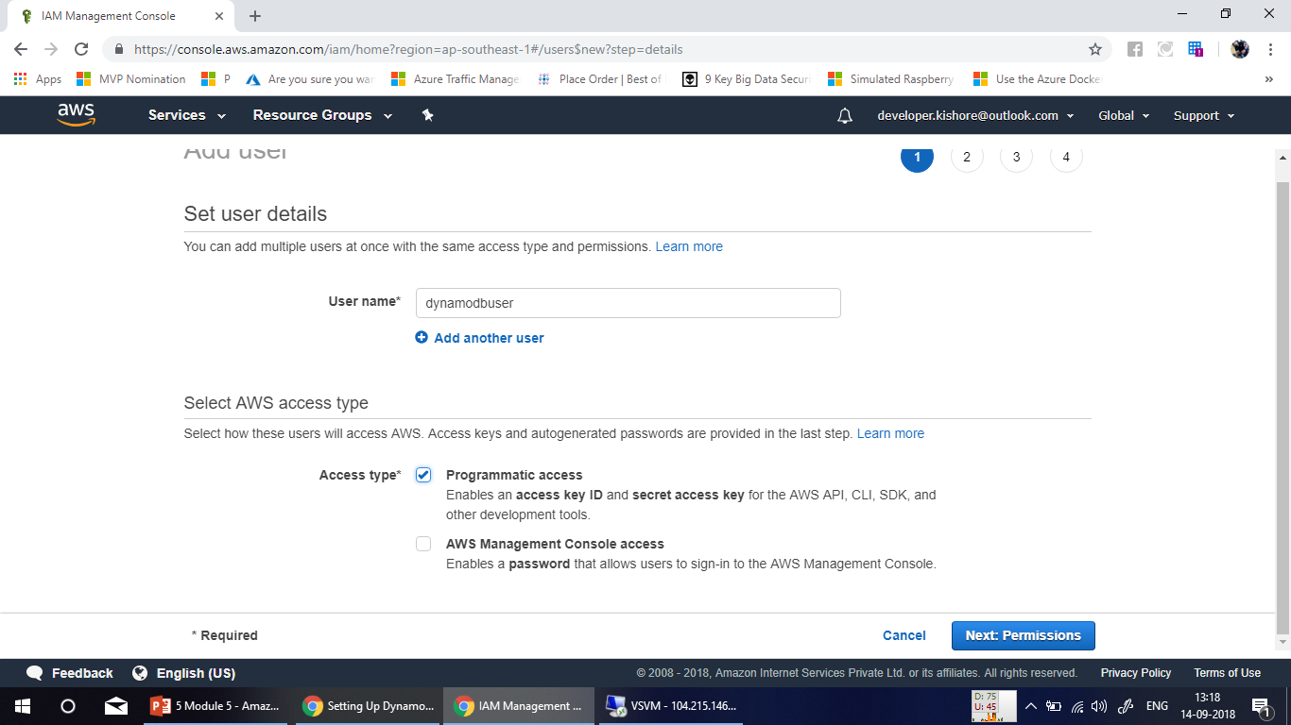

Slide 29
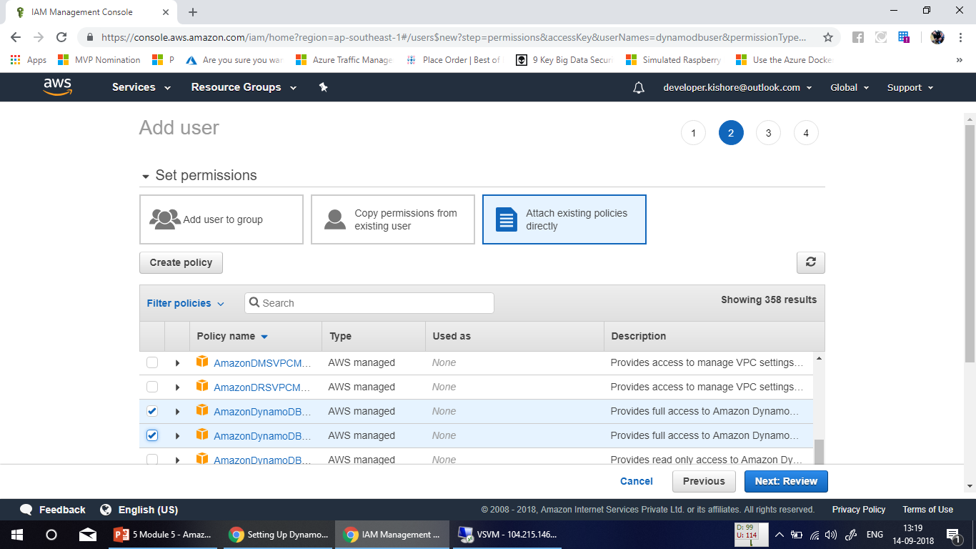

Slide 30
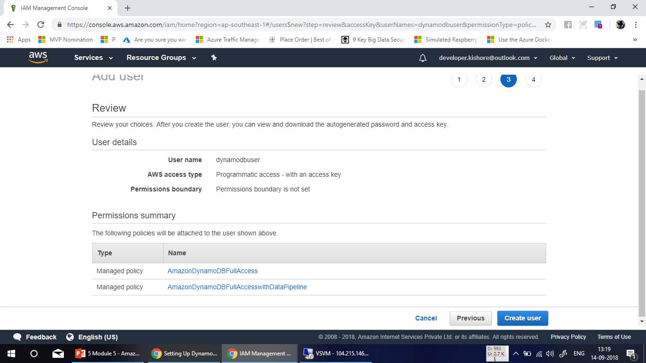

Slide 31
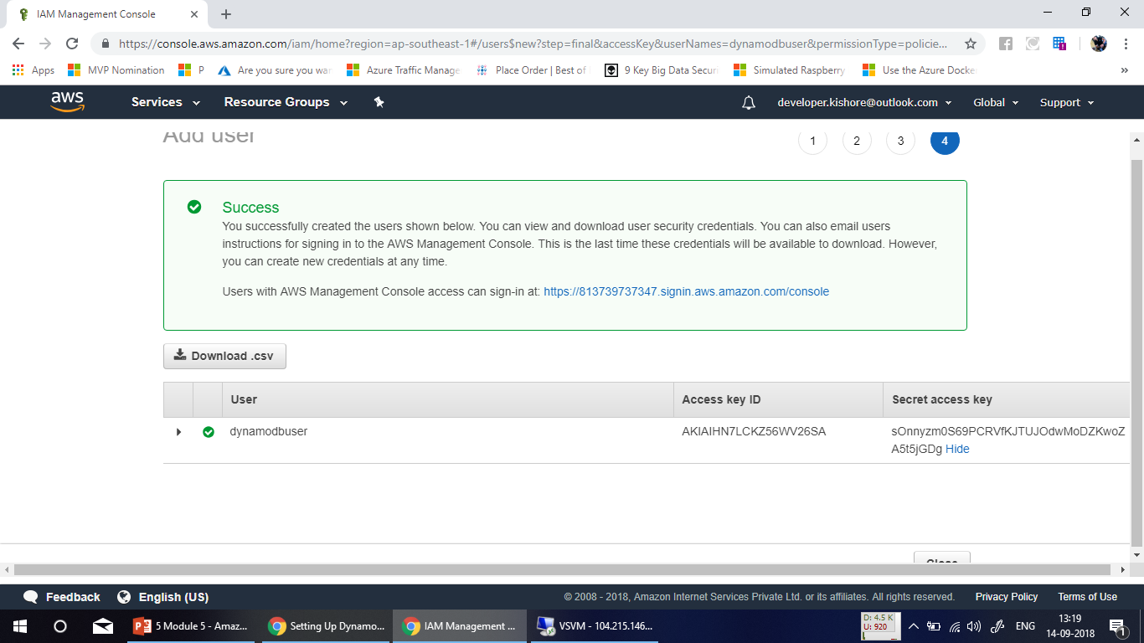

Slide 32
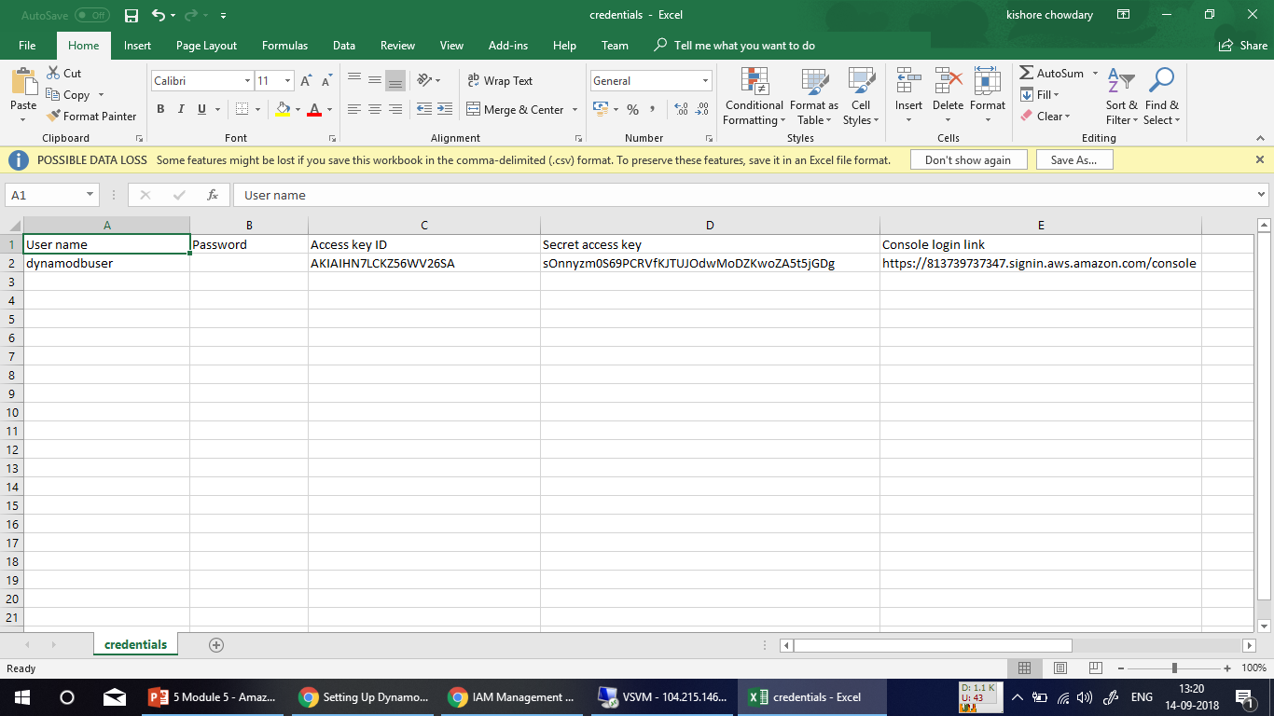

Slide 33
Loading Sample Data
In this demo, you will use the AWS Management Console to create tables in DynamoDB for two simple use cases.
Use Case 1: Product Catalog
Use Case 2: Forum Application

Slide 34
Use Case 1: Product Catalog
Suppose you want to store product information in DynamoDB. Each product has its own distinct attributes, so you will need to store different information about each of these products.
You can create a ProductCatalog table, where each item is uniquely identified by a single, numeric attribute: Id.
Table Name | Primary Key
ProductCatalog | Partition key: Id (Number)

Slide 35
Demo - Creating Product Catalog Table

Slide 36
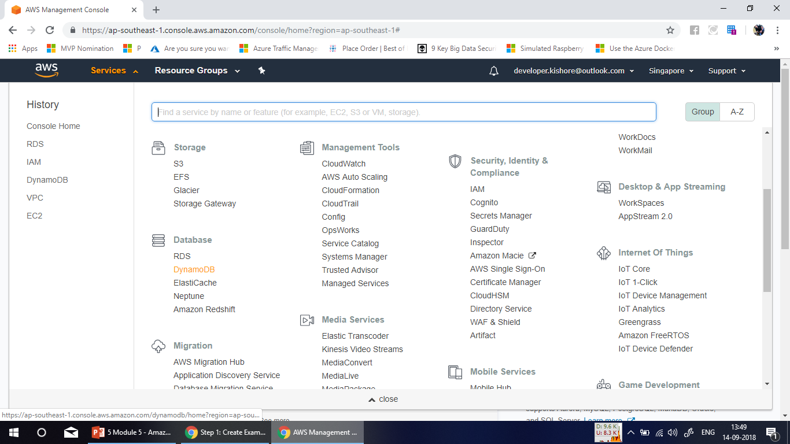

Slide 37
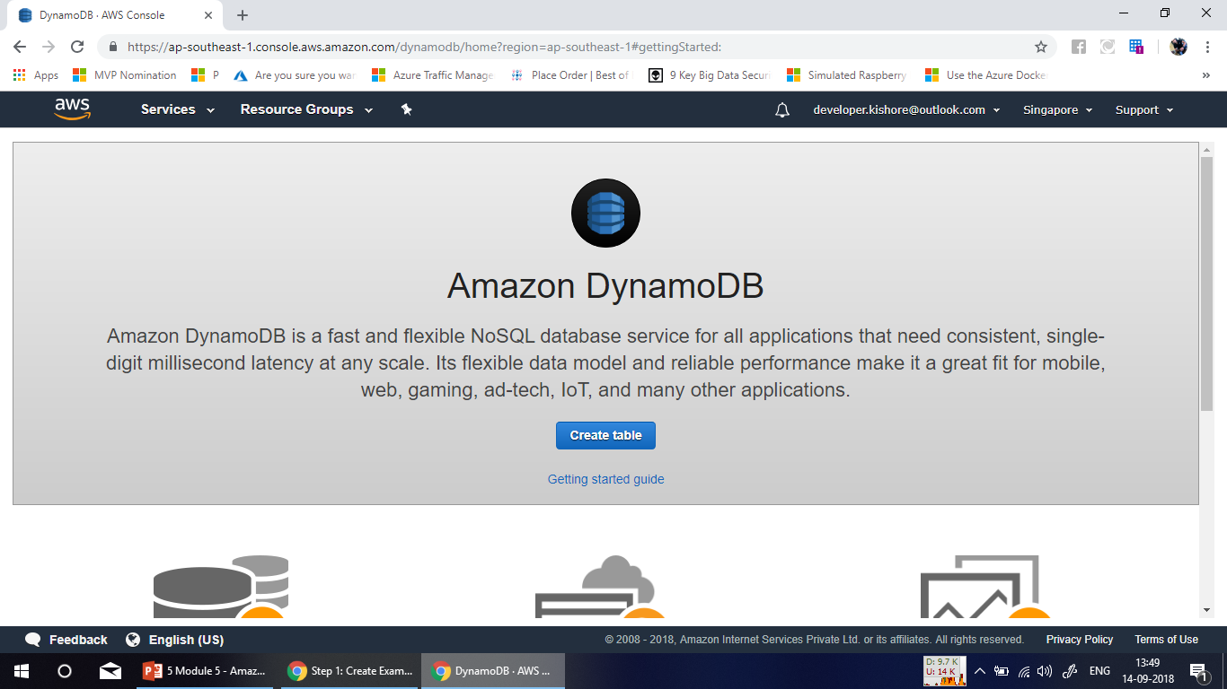

Slide 38
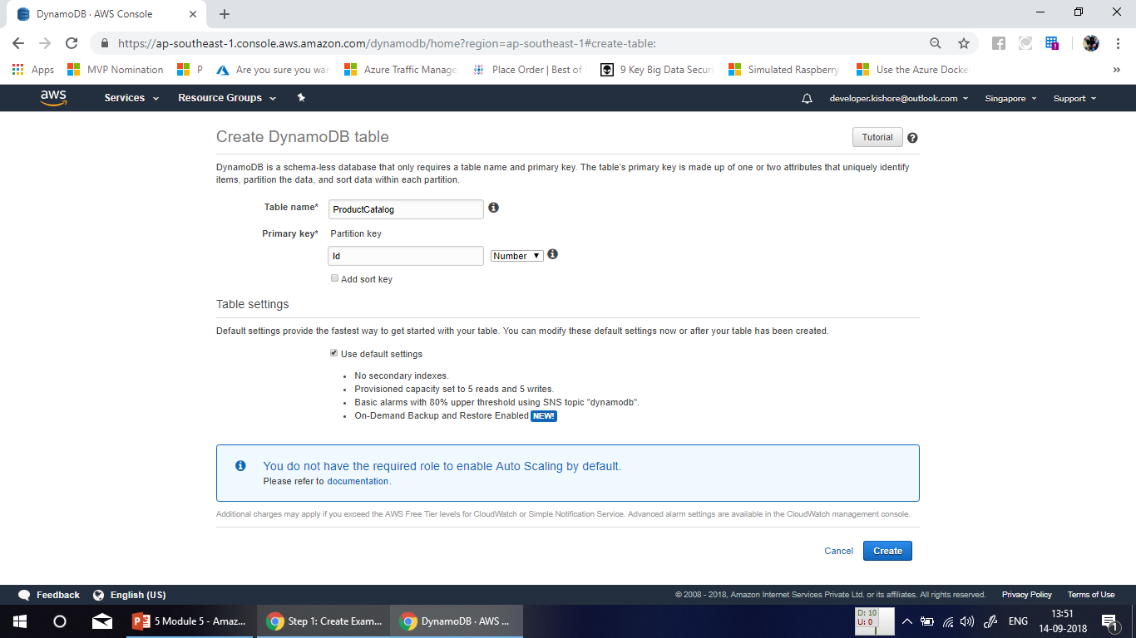

Slide 39
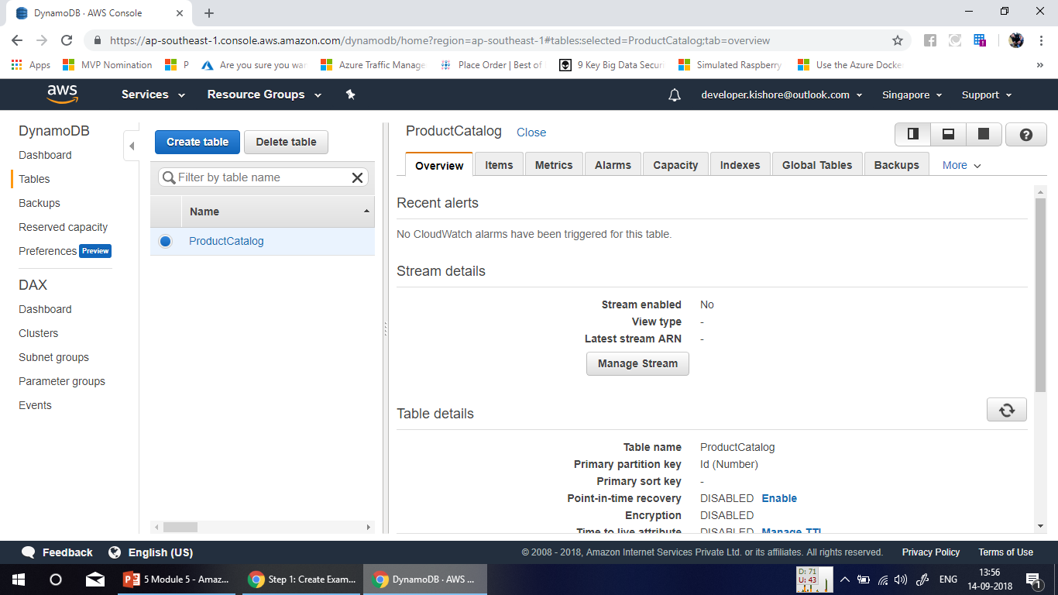

Slide 40
Use Case 2: Forum Application
Suppose you want to build an application for message boards, or discussion forums. The Amazon Web Services Discussion Forums is one example of such an application: Customers can engage with the developer community, ask questions, or reply to other customers' posts. Each AWS service has a dedicated forum. Anyone can start a new discussion thread by posting a message in a forum. Each thread might receive any number of replies.
You can model this application by creating three tables: Forum, Thread, and Reply.
Table Name | Primary Key
Forum | Partition key: Name (String)
Thread | Partition key: ForumName (String) Sort key: Subject (String)
Reply | Partition key: Id (String) Sort key: ReplyDateTime (String)

Slide 41
Index
Index Name | Primary Key
PostedBy-Message-Index | Partition key: PostedBy (String) Sort key: Message (String)
The Reply table has a global secondary index named PostedBy-Message-Index. This index will facilitate queries on two non-key attributes of the Reply table.

Slide 42
Demo - Creating Forum Table

Slide 43


Slide 44
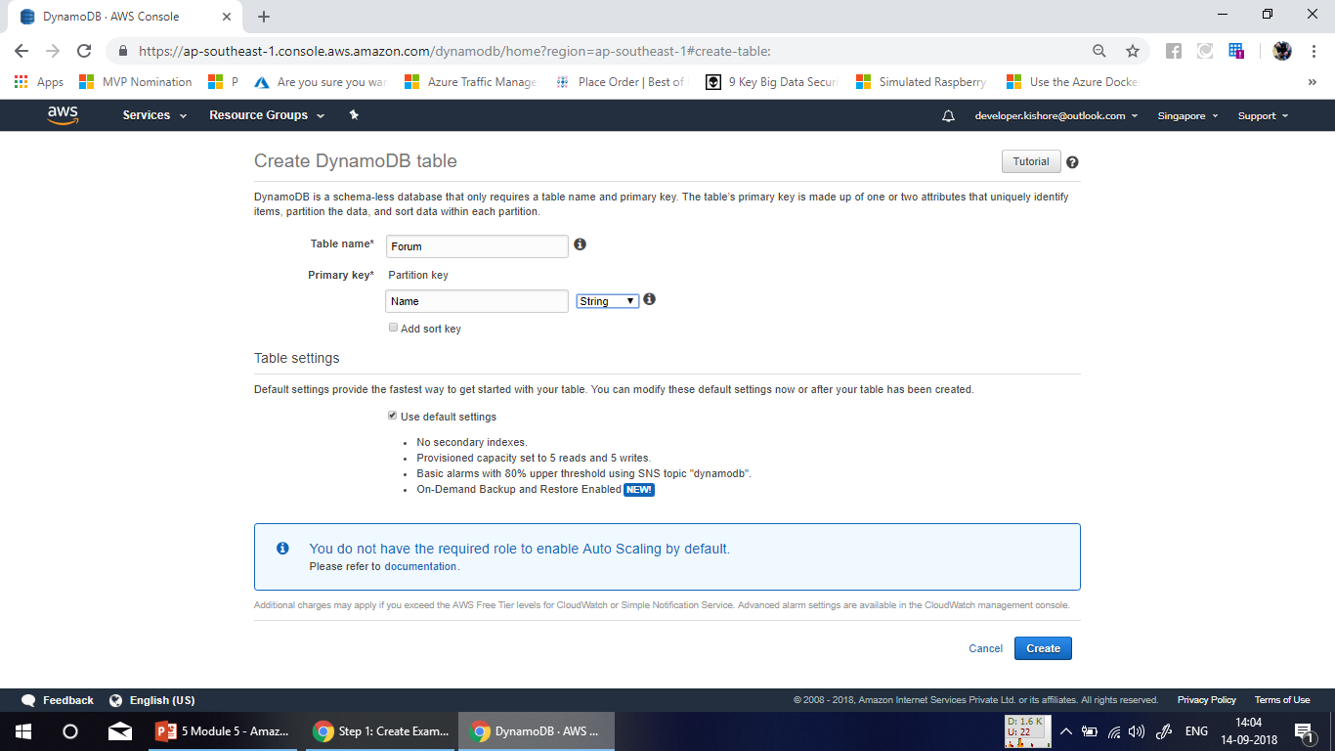

Slide 45
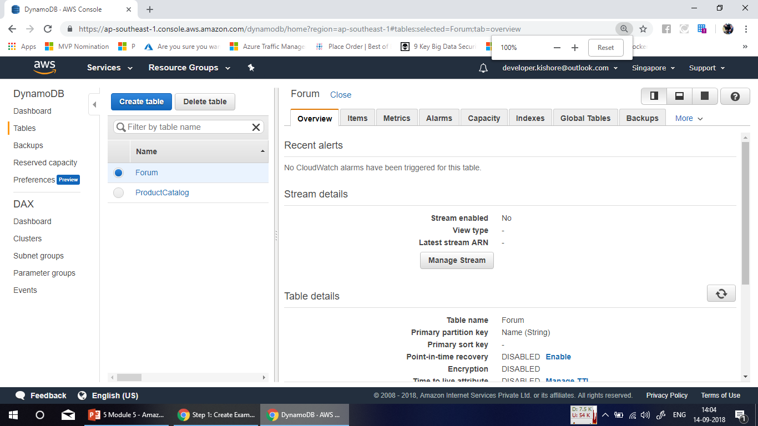

Slide 46
Demo – Creating Thread Table

Slide 47
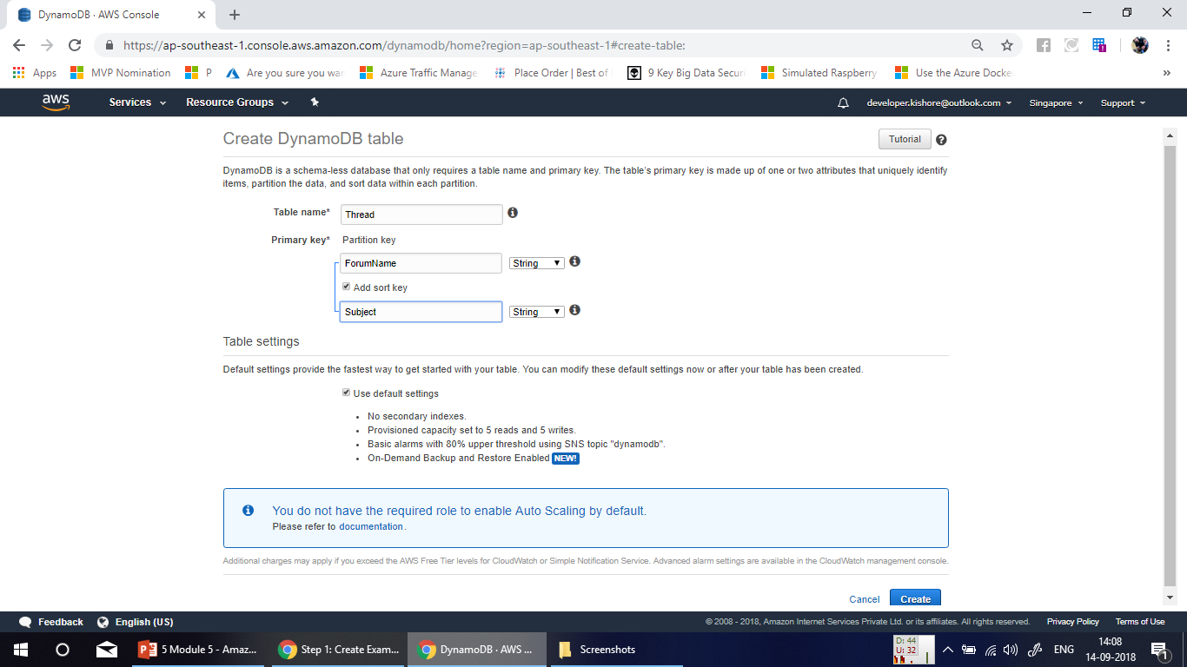

Slide 48
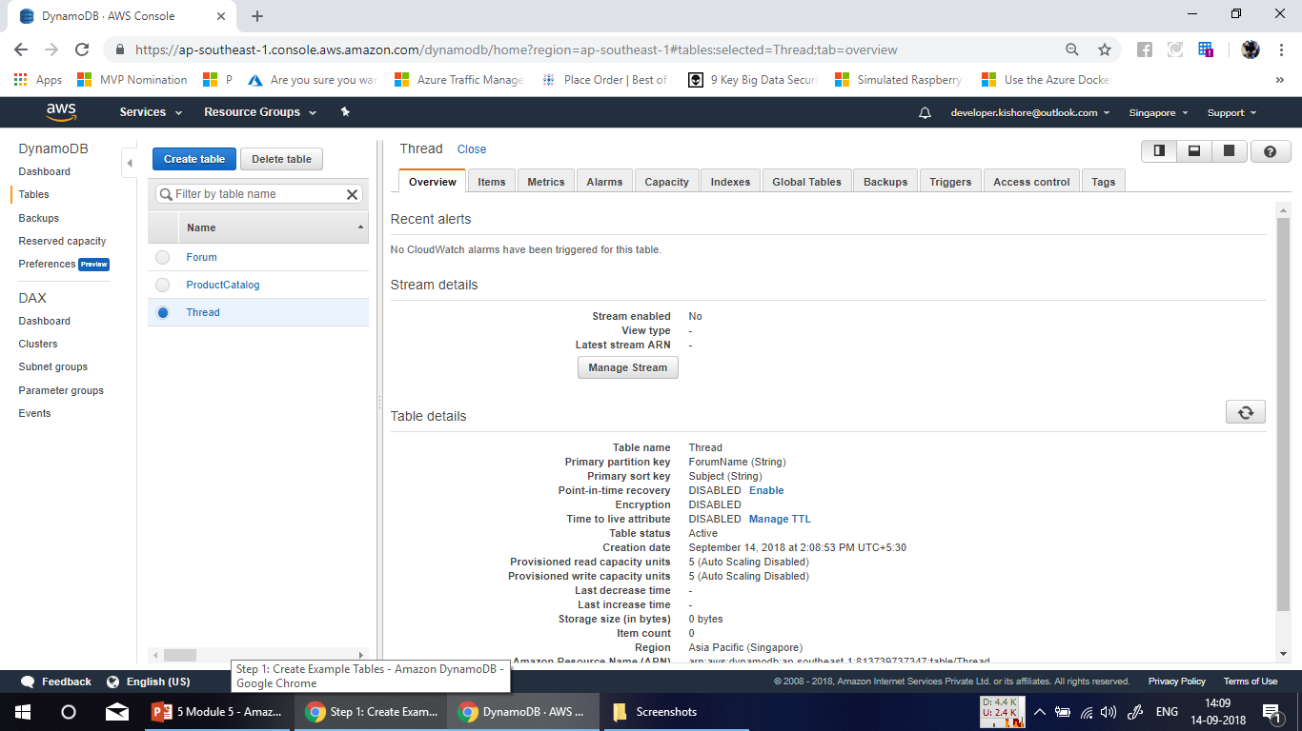

Slide 49
Demo – Creating Reply Table

Slide 50
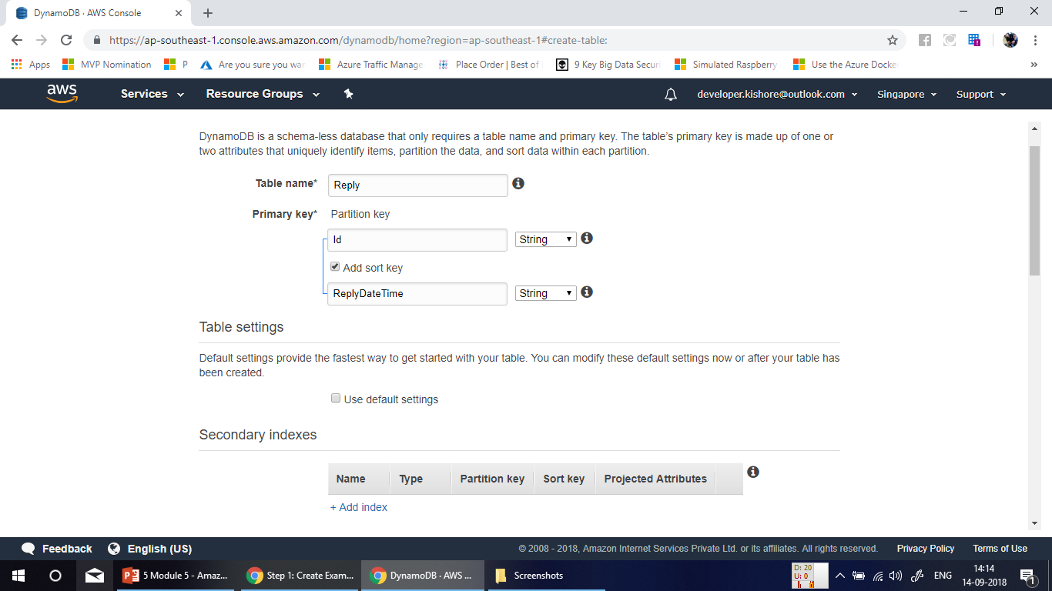

Slide 51
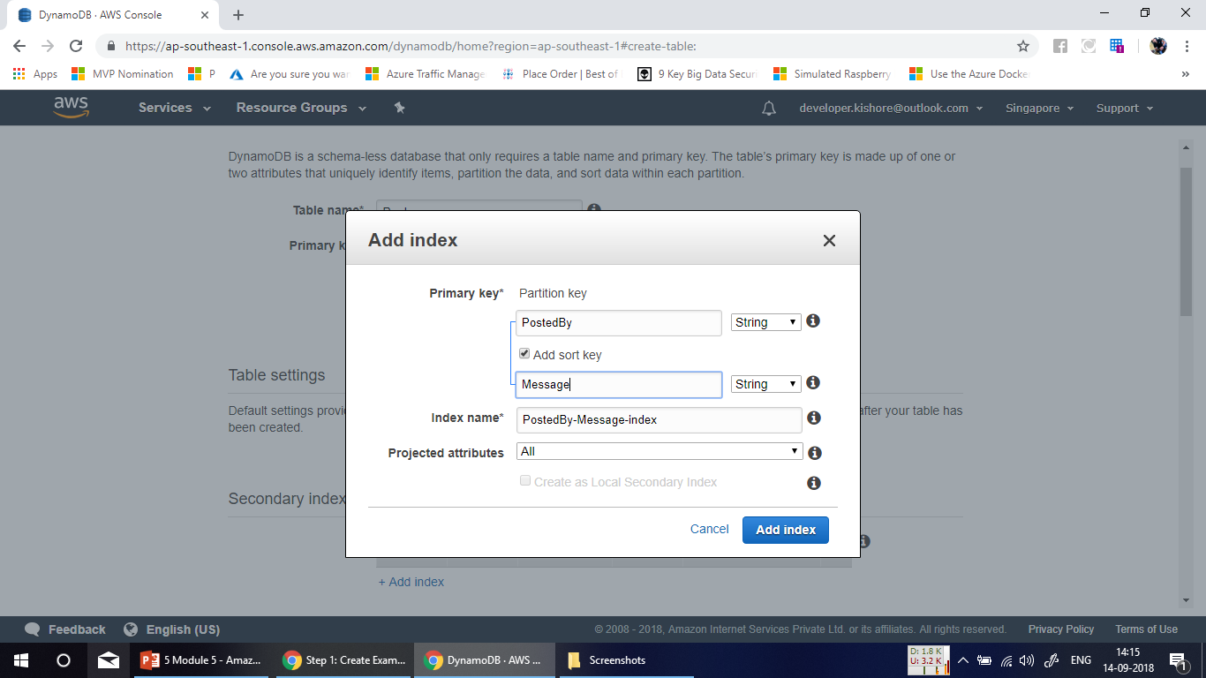

Slide 52
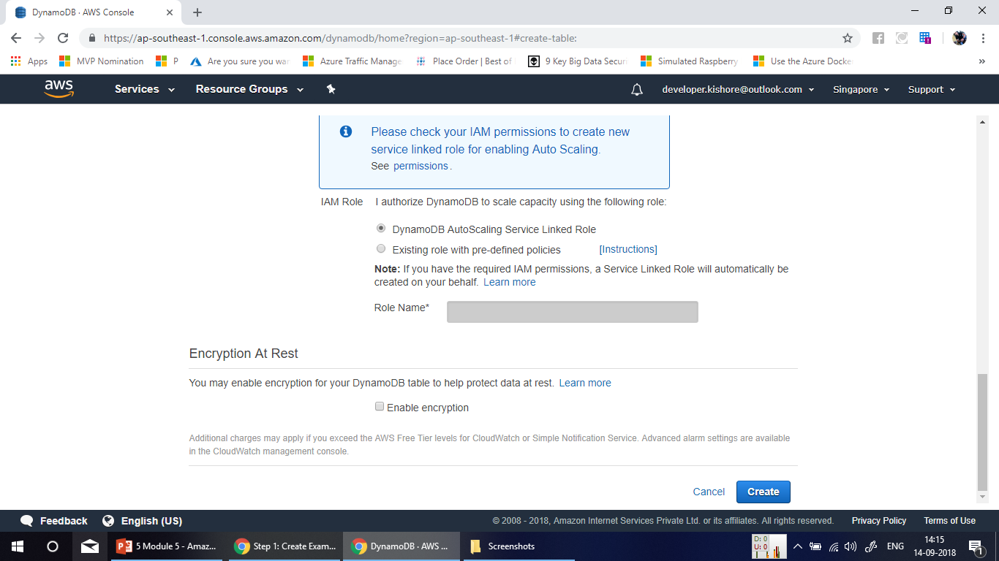

Slide 53
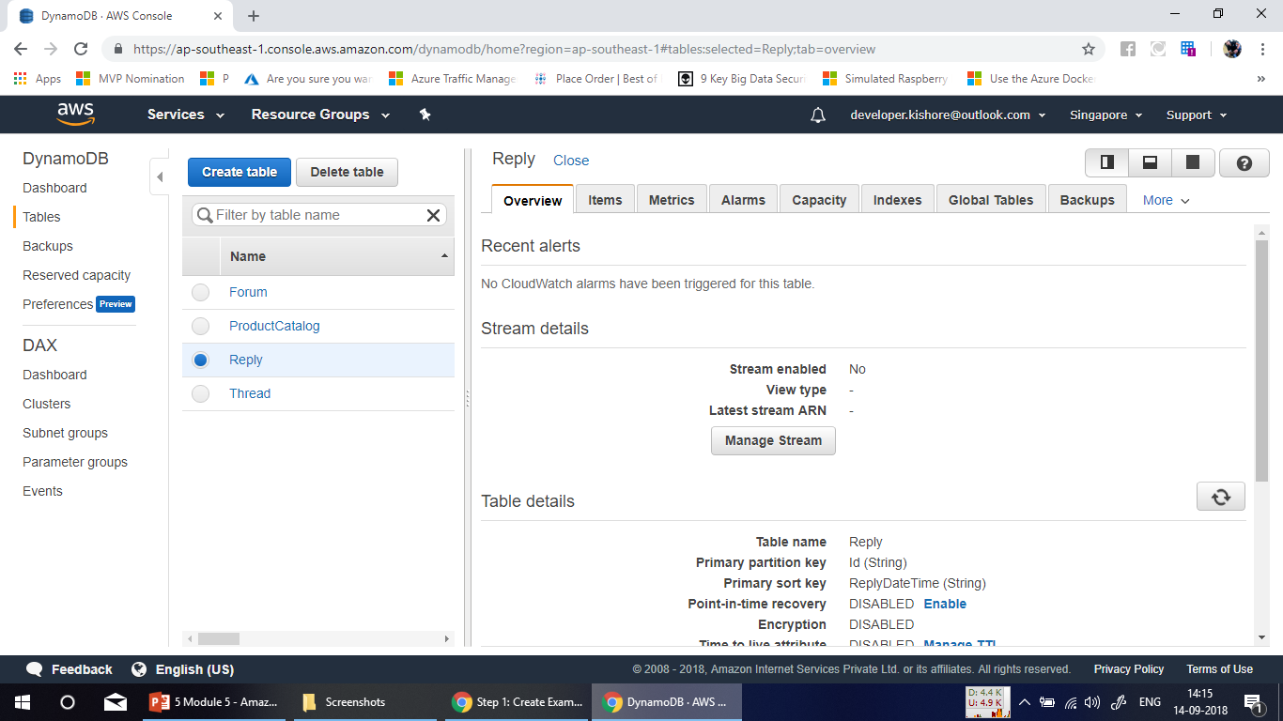

Slide 54
Loading Sample Data into Tables
In this step, you will load sample data into the tables that you created. You could enter the data manually into the DynamoDB console; however, to save time, you will use the AWS Command Line Interface instead.

Slide 55
Accessing DynamoDB using AWS CLI
We can use AWS CLI to work with AWS DynamoDB. To Implement CLI environment, explore the following link - https://docs.aws.amazon.com/amazondynamodb/latest/developerguide/Tools.CLI.html
You can download the CLI from here - https://s3.amazonaws.com/aws-cli/AWSCLI64PY3.msi

Slide 56
Demo – Loading Sample Data into Tables
For the sample demo, download sample data from here - https://docs.aws.amazon.com/amazondynamodb/latest/developerguide/samples/sampledata.zip
Extract them and navigate to the directory and run the commands to load data.

Slide 57
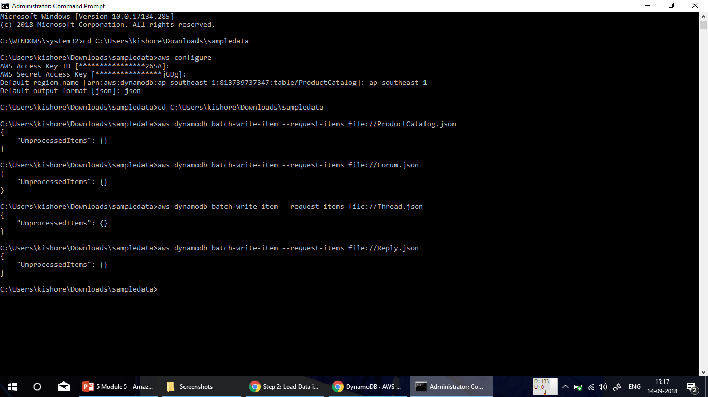

Slide 58
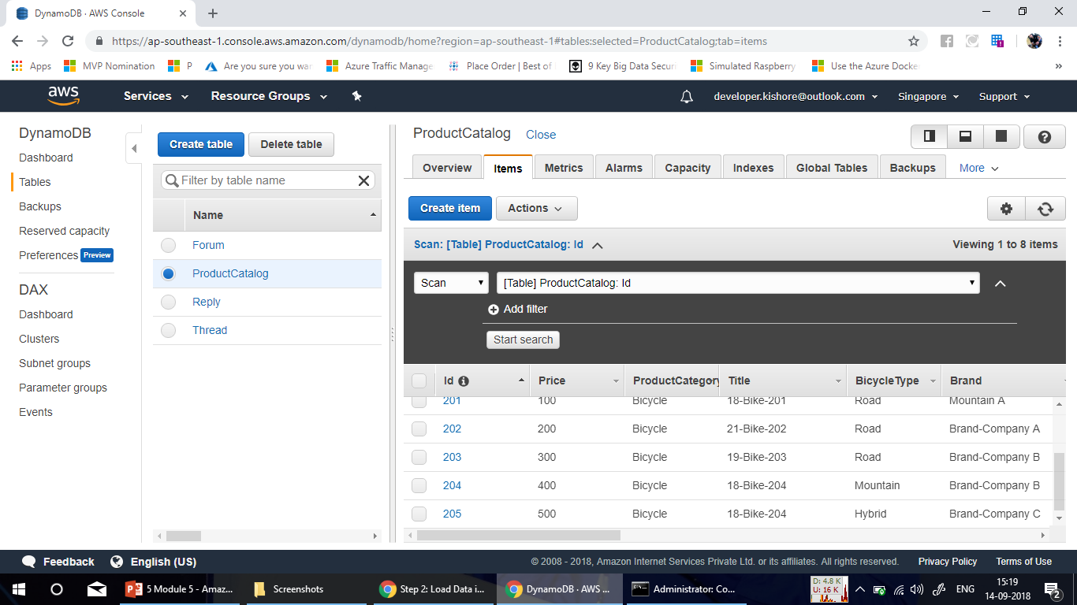

Slide 59
Summary
Understanding Aurora DB
Core Components of Aurora DB
Primary Keys and Sort Keys
Dynamo DB Streams
Creating Tables
Loading Data into Tables
Backup and Restore

